Slide 1
Simple linear regression:
Examples

Slide 2
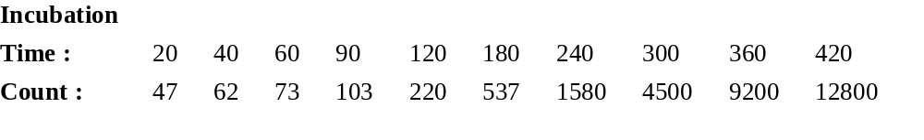
Problem Name: Cell Growth
Application: Transformations with Simple Linear Regression
Problem Description: In a cell growth experiment, the growth of a bacterial colony was observed at regular intervals over a period of seven hours. The purpose of the experiment was to try to determine an appropriate relationship for colony growth, measured by counting the number of bacteria per cm³ in the tray being used, as a function of time. The data are

Slide 3
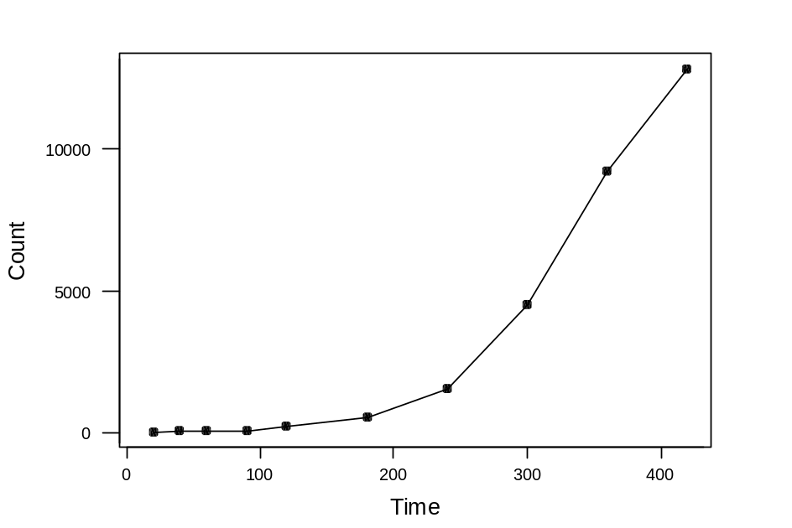
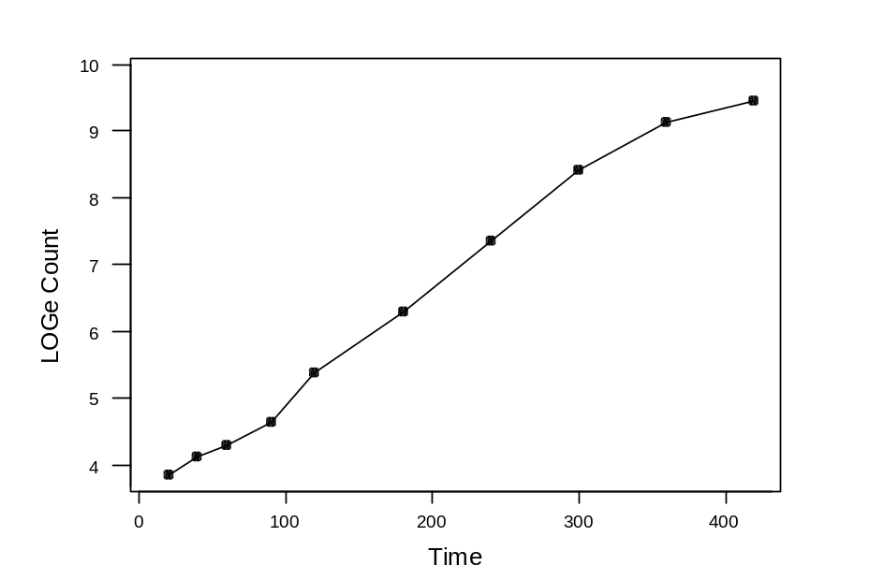

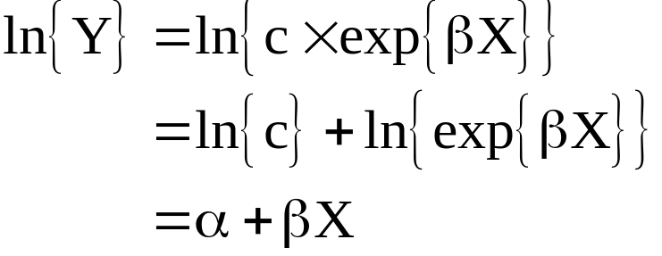
The ‘actual’ relationship between Y and X is
so that

Slide 4
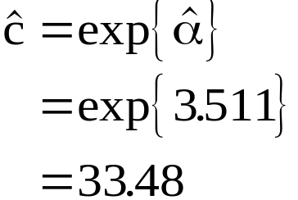

Regression Analysis
The regression equation is
Lcount = 3.51 + 0.0152 Time
Predictor Coef StDev T P
Constant 3.5110 0.1277 27.50 0.000
Time 0.0152093 0.0005631 27.01 0.000
S = 0.2384 R-Sq = 98.9% R-Sq(adj) = 98.8%
^
β
^
α
so that...

Slide 5
Year | Mbbl |  | Year | Mbbl
1880 | 30 |  | 1960 | 7674
1890 | 77 |  | 1962 | 8882
1900 | 149 |  | 1964 | 10310
1905 | 215 |  | 1966 | 12016
1910 | 328 |  | 1968 | 14104
1915 | 432 |  | 1970 | 16690
1920 | 689 |  | 1972 | 18584
1925 | 1069 |  | 1974 | 20389
1930 | 1412 |  | 1976 | 20188
1935 | 1655 |  | 1978 | 21922
1940 | 2150 |  | 1980 | 21732
1945 | 2595 |  | 1982 | 19403
1950 | 3803 |  | 1984 | 19608
1955 | 5626
Problem Name: World Crude Oil Production
Problem Description: The data are measurements of annual world crude oil production in millions of barrels, 1880-1984. The increase in annual world crude oil production from 1880 to 1973 follows a pattern of exponential growth. In order to fit a linear model to these data, the oil production variable must be transformed by taking the natural log.

Slide 6
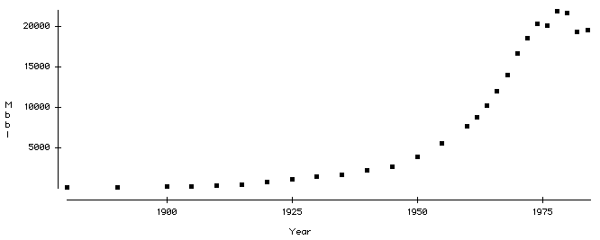
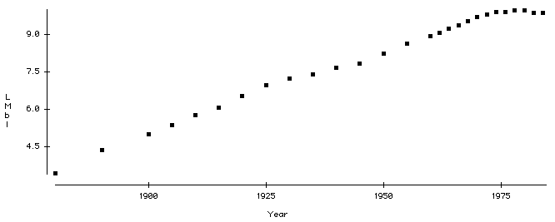

Slide 7
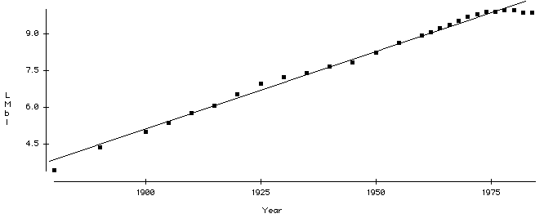
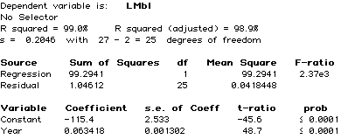

Slide 8
Problem Name: Forbes top 500
Application: Transformations with SLR
Problem Description: Facts about companies selected from the Forbes 500 list for 1986. This is a 1/10 systematic sample from the alphabetical list of companies. The Forbes 500 includes all companies in the top 500 on any of the criteria, and thus has almost 800 companies in the list. We consider 79 companies here. We will look at the variables Sales and Assets and towards the conclusion of the example break these down by industrial sector.

Slide 9
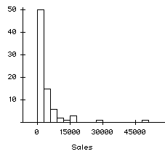
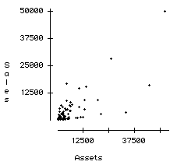
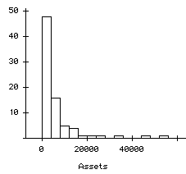

Slide 10
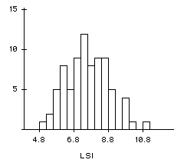
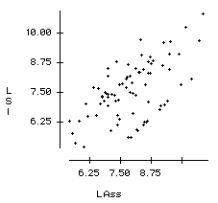
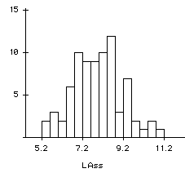

Slide 11
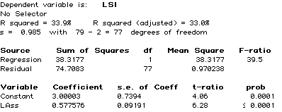

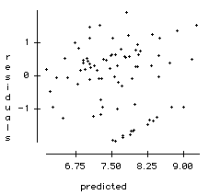
?

Slide 12
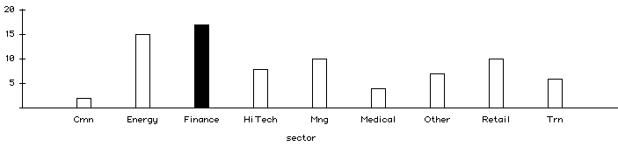
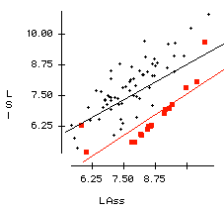
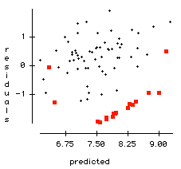

Slide 13
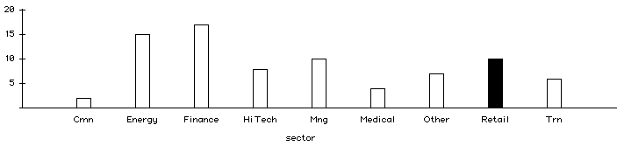
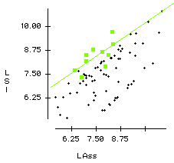
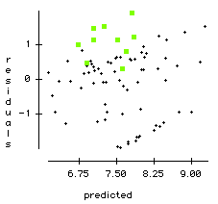

Slide 14
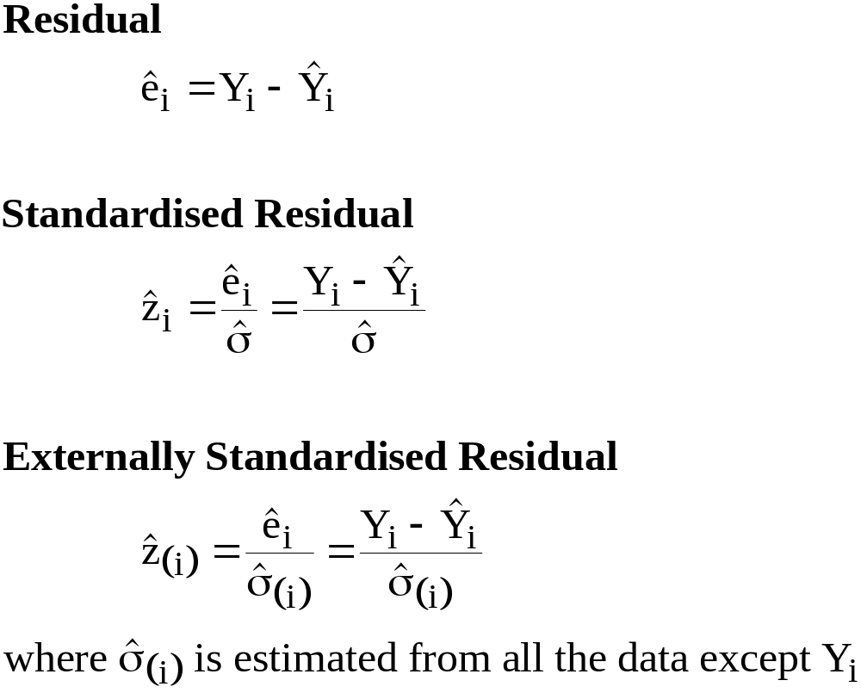
Residual = DATA - FITTED VALUE

Slide 15
Residuals should display only a constant pattern of variation.

Slide 16
Sales Training Example Data from an experiment on the number of days of training received (X) on performance (Y) in a battery of simulated sales situations are presented below:
Sales Trainee | Days of Training | Performance Score | √Day
1 | 0.5 | 42.5 | 0.707
2 | 0.5 | 50.6 | 0.707
3 | 1 | 68.5 | 1
4 | 1 | 80.7 | 1
5 | 1.5 | 89 | 1.225
6 | 1.5 | 99.6 | 1.225
7 | 2 | 105.3 | 1.414
8 | 2 | 111.8 | 1.414
9 | 2.5 | 112.3 | 1.581
10 | 2.5 | 125.7 | 1.581

Slide 17
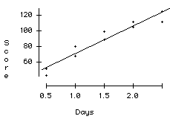
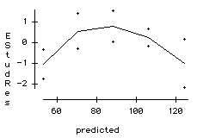
A scatterplot of ‘Score’ against ‘Days’ with a superimposed regression line is shown below. Also shown is a plot of the ‘Externally Studentised Residuals’ against the ‘Predicted Values’. Simple linear regression would be inappropriate here as there is a clear curve-linear feature in these data.

Slide 18
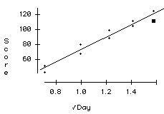
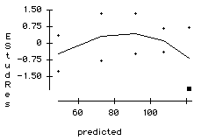
A square root transformation of variable ‘Days’ was taken and the regression procedure reapplied. While the relationship between ‘Score’ and ‘Days’ is curve-linear, the relationship between ‘Score’ and ‘√Days’ is linear. Regression can be legitimately applied to the transformed variables.

Slide 19
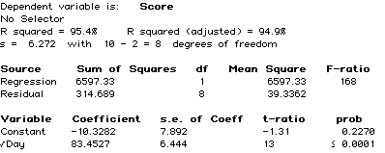
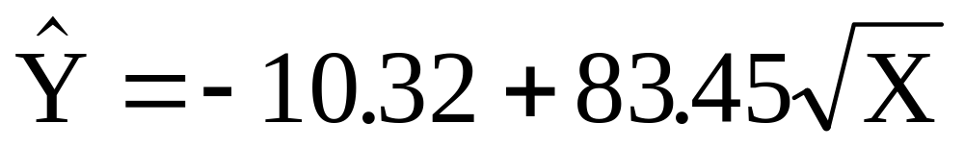
The estimated non-linear relationship between ‘Sales’ and ‘Days’ is

Slide 20
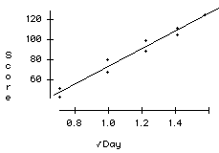
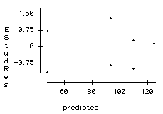
A slight improvement can be made to the shape of the diagnostic plot above by considering omitting the highlighted observation. The resulting plots and fit are…

Slide 21
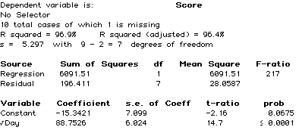
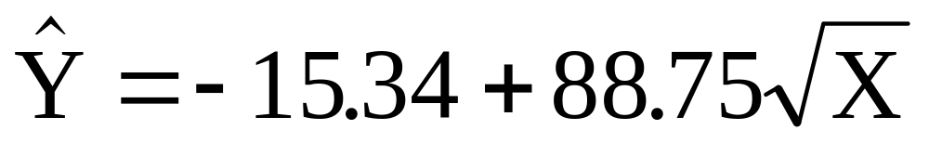
Notice how influential a single point can be! The estimated non-linear relationship between ‘Sales’ and ‘Days’ is now

